Slide 1
Decoding Digital Purchase Intent
April 25, 2024
By: Priyanka Bhosale

Slide 2
AGENDA
1. Introduction
2. Dataset Details: Collection and Column Description
3. Exploratory Data Analysis
4. Data pre-processing and Feature Engineering
5. Sampling
6. Model Selection
7. Model Fitting & Evaluation
8. Feature Importance
9. Conclusion

Slide 3
Introduction
Understanding online purchase intent has become a pivotal focus for businesses in the digital age
Analyzing customer behavior and intent is essential for targeted and effective marketing that helps businesses grow
Studying browsing patterns and demographic information, businesses can predict customer purchase intent and tailor their strategies to maximize conversions
This project aims to develop several machine learning models that predict customer purchase intent, providing valuable insights for businesses to optimize their marketing efforts and enhance customer engagement

Slide 4
Data Collection
The data utilized in this project was obtained from UC Irvine Machine Learning Repository
It consists e-commerce user information
Total records: 12,330
Each row represents a session that belongs to a different user in a 1-year period
Total features: 18
10 numerical
8 categorical

Slide 5
Feature Details
Numerical Features Categorical Features
Column | Details
Administrative | No. of administrative pages that the user visited
Administrative_Duration | Amount of time, in seconds, spent in this category of pages
Informational | No. of informational pages that the user visited
Informational_Duration | Amount of time, in seconds, spent in this category of pages
ProductRelated | No. of product-related pages that the user visited
ProductRelated_Duration | Amount of time spent, in seconds, in this category of pages
BounceRates | Percentage of visitors who enter the website through that page and exit without triggering any additional tasks
ExitRates | Percentage of page views that end at that specific page
PageValues | Average value for a page that a user visited before landing on the goal page or completing the transaction (or both)
SpecialDay | Closeness of the browsing date to special days or holidays
Column | Details
Month | Contains the month the pageview occurred
OperatingSystems | Operating system that the user used when viewing the page
Browser | Browser of the visitor
Region | Geographic region from which the session has been started by the visitor
TrafficType | Type of traffic the user is categorized into
VisitorType | Whether a visitor is New Visitor, Returning Visitor, or Other
Weekend | Whether the session is on a weekend
Revenue | Whether or not the user completed the purchase
Target Variable

Slide 6
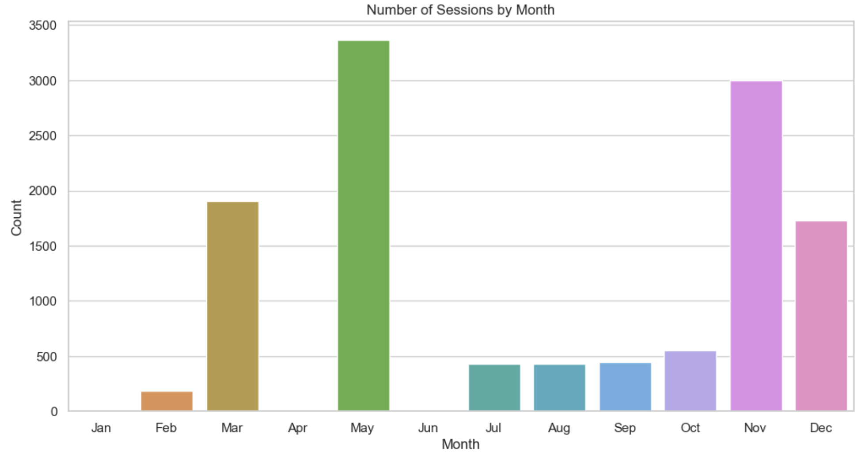
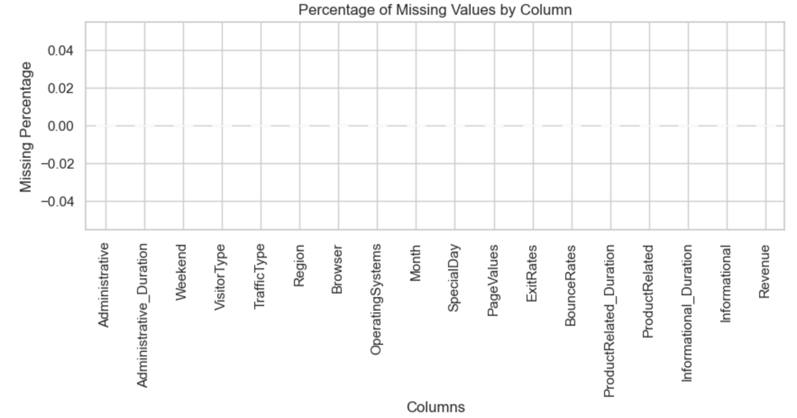
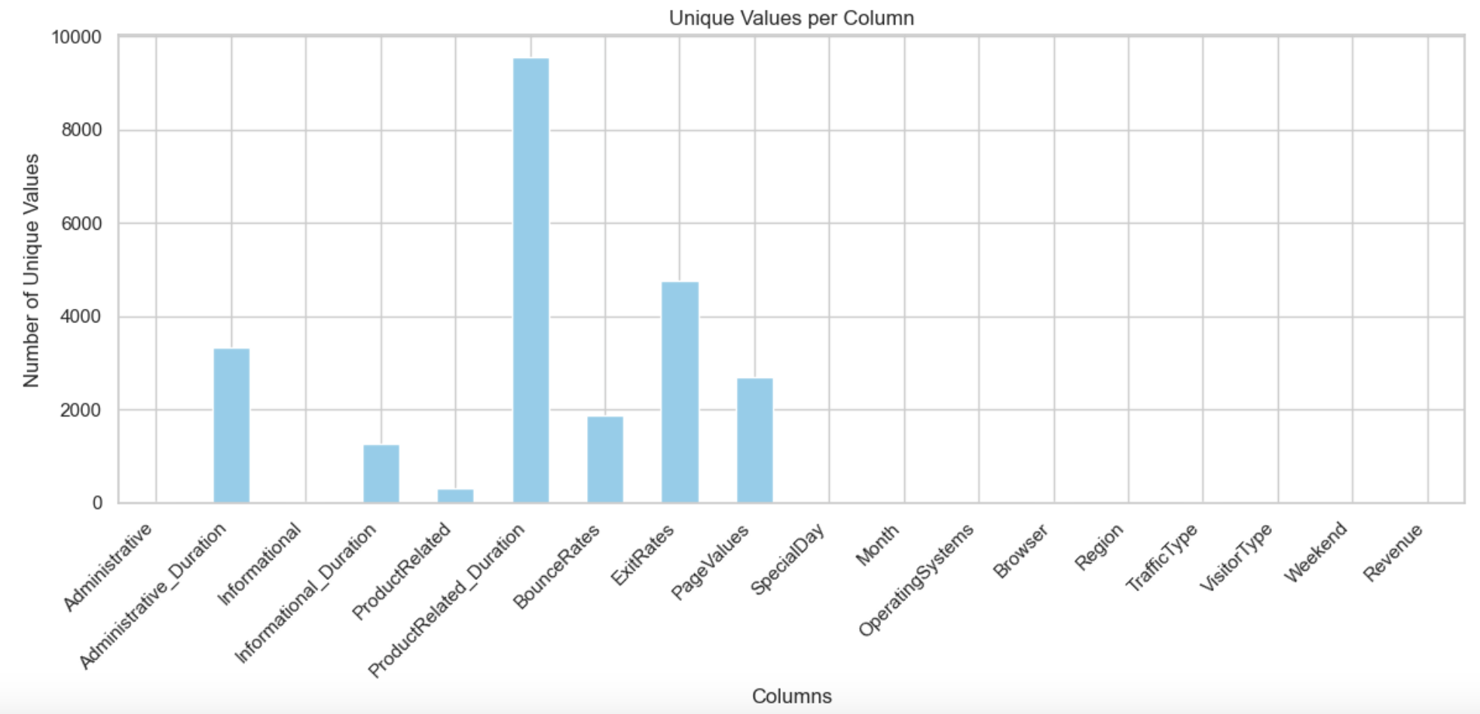
Exploratory Data Analysis

Slide 7
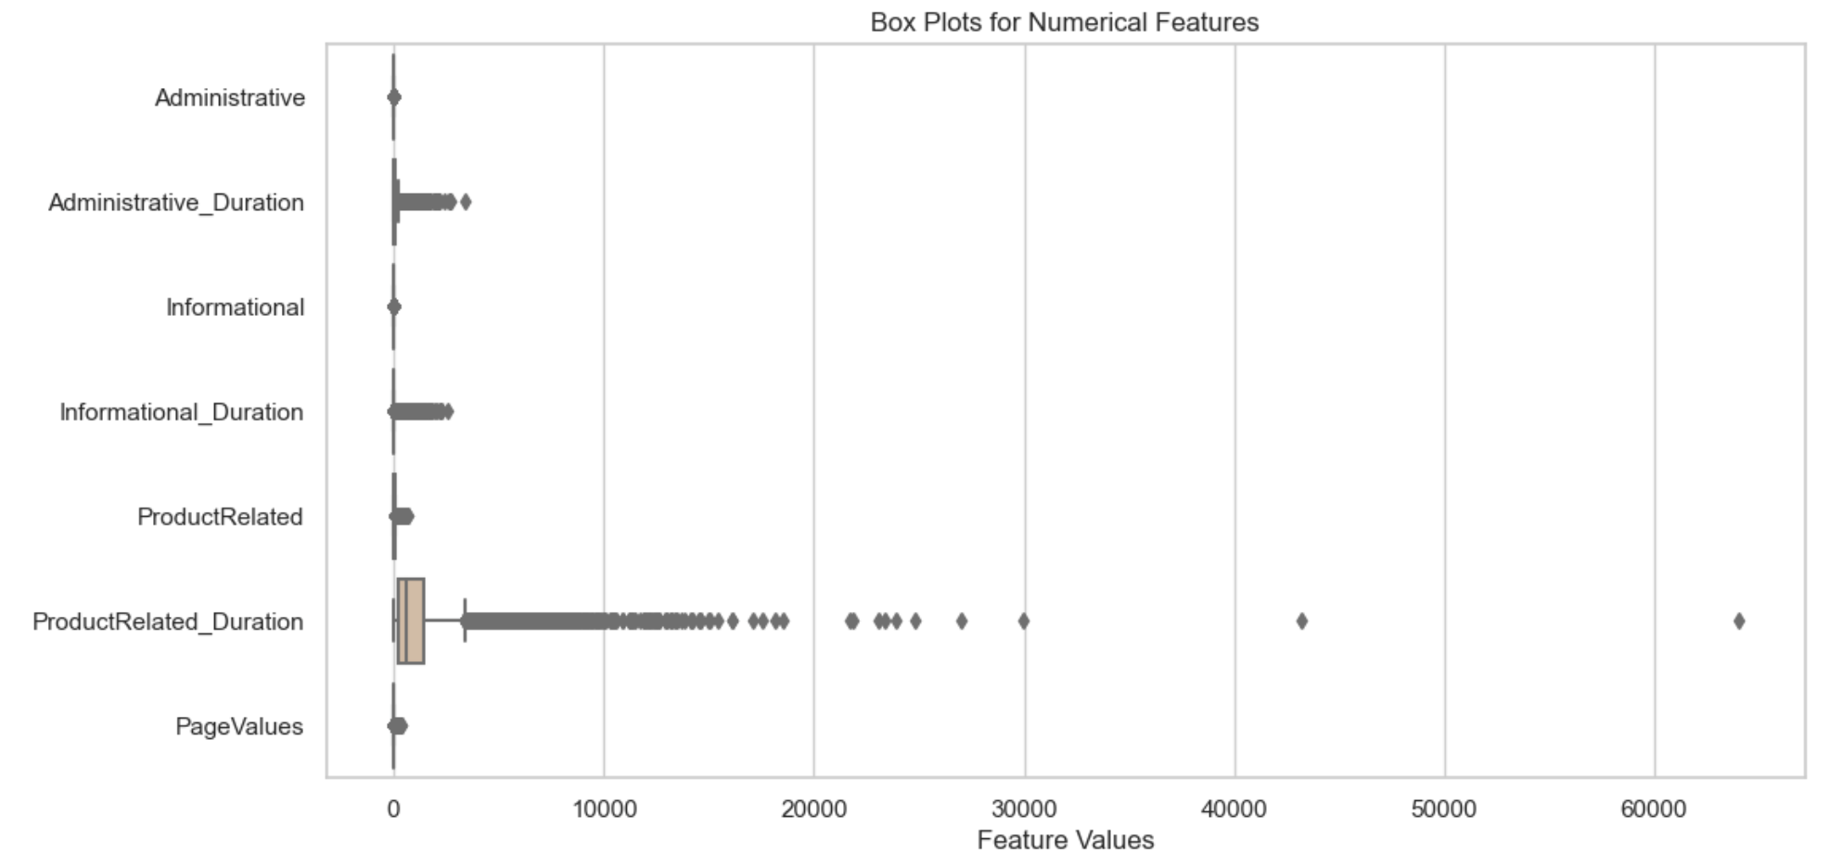
Outliers

Slide 8
Data Pre-processing and Feature Engineering
Label encoding for features to convert categorical into numerical labels: Weekend and Revenue
True and False values converted into 1 and 0
One-Hot Encoding for column VisitorType: k-1 columns created to prevent multicollinearity
Unique Values: Returning_Visitor, New_Visitor, Other
Converted to: VisitorType_Returning_Visitor and VisitorType_Other
Dropped feature Month: 2 months missing data for Jan and April, time-sensitivity information was captured by column SpecialDay
Converted Administrative_Duration, Informational_Duration, ProductRelated_Duration from seconds to hours
Normalization: Min-Max Scaling technique used (MinMaxScaler) to scale down to a fixed range between 0 and 1

Slide 9
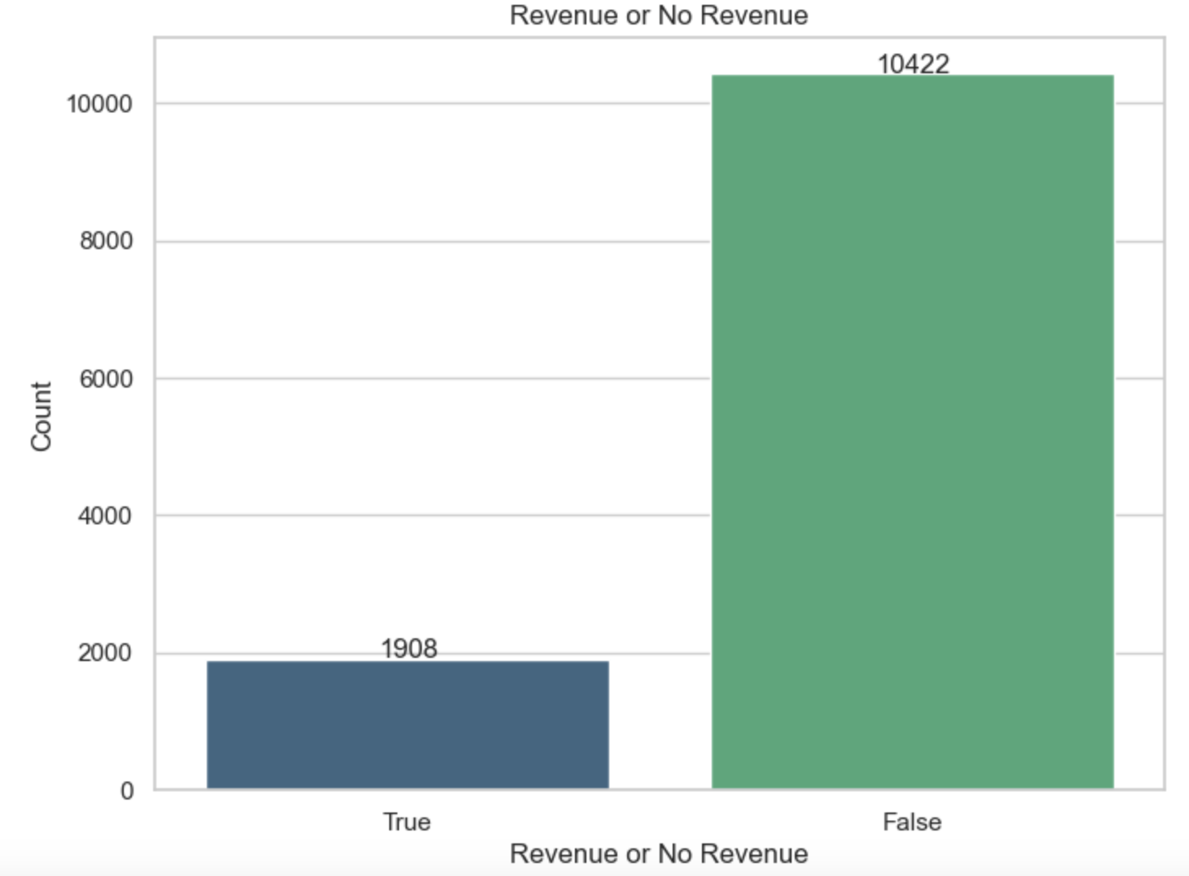
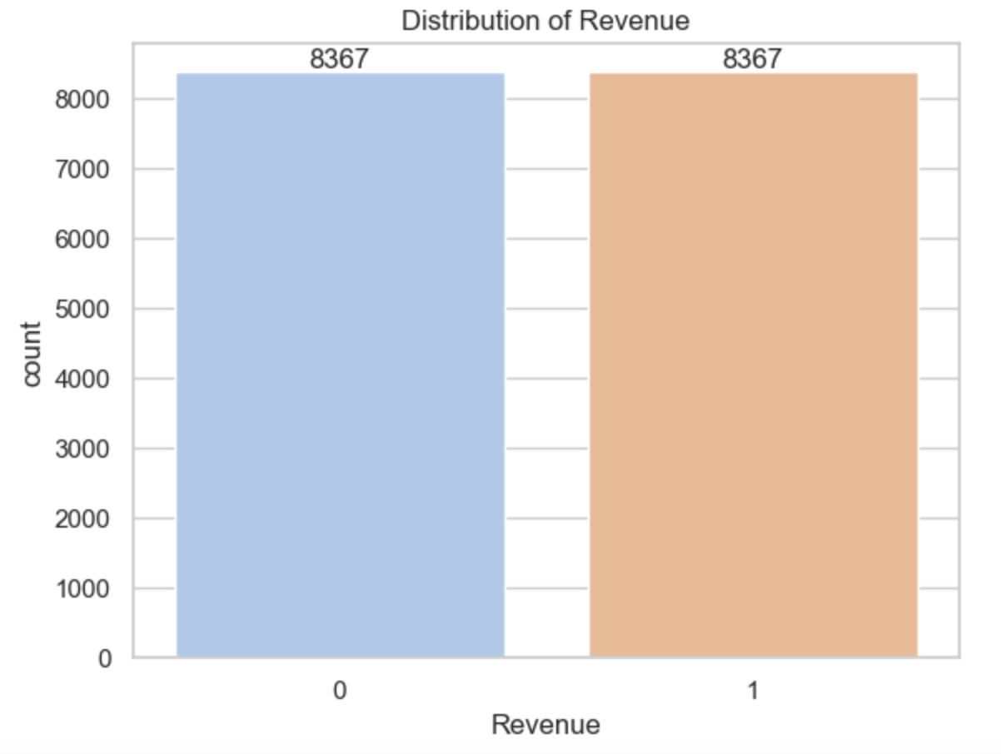
Sampling on Train Set
Resampling Treatment: Over-sampling using SMOTE for a balanced Target Feature
Train:Test set ratio = 80:20

Slide 10
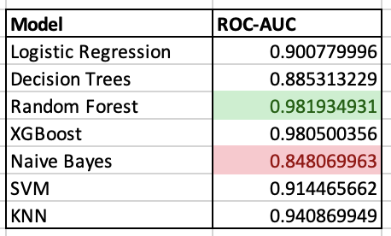
Model Selection
Classification Models:
Logistic Regression
Decision Tree
Random Forest
XGBoost
Naïve Bayes
Support Vector Machines (SVM)
K-Nearest Neighbors (KNN)
Comparing with Dummy Classifier model
Reason: Simple baseline classifier used as a reference point for comparing the performance of other classifiers
Strategy: stratified, because it generates predictions by respecting the class distribution of the training set

Slide 11
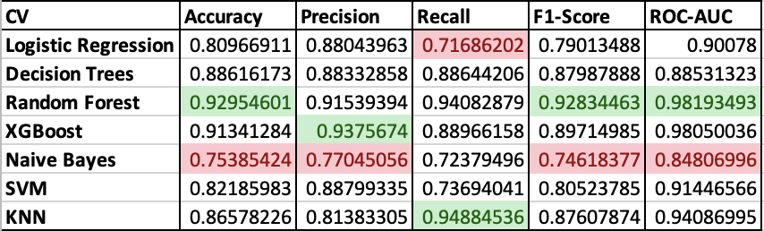
Model Fitting & Evaluation
The Classification Models listed were trained and evaluated on the dataset using 5-fold cross-validation
The model with the highest average ROC AUC score was chosen as the best performer, which was the Random Forest model
Why ROC and AUC score: It provides a comprehensive measure of a model's performance across all classification thresholds, making it robust against imbalanced data compared to other metrics, such as accuracy

Slide 12
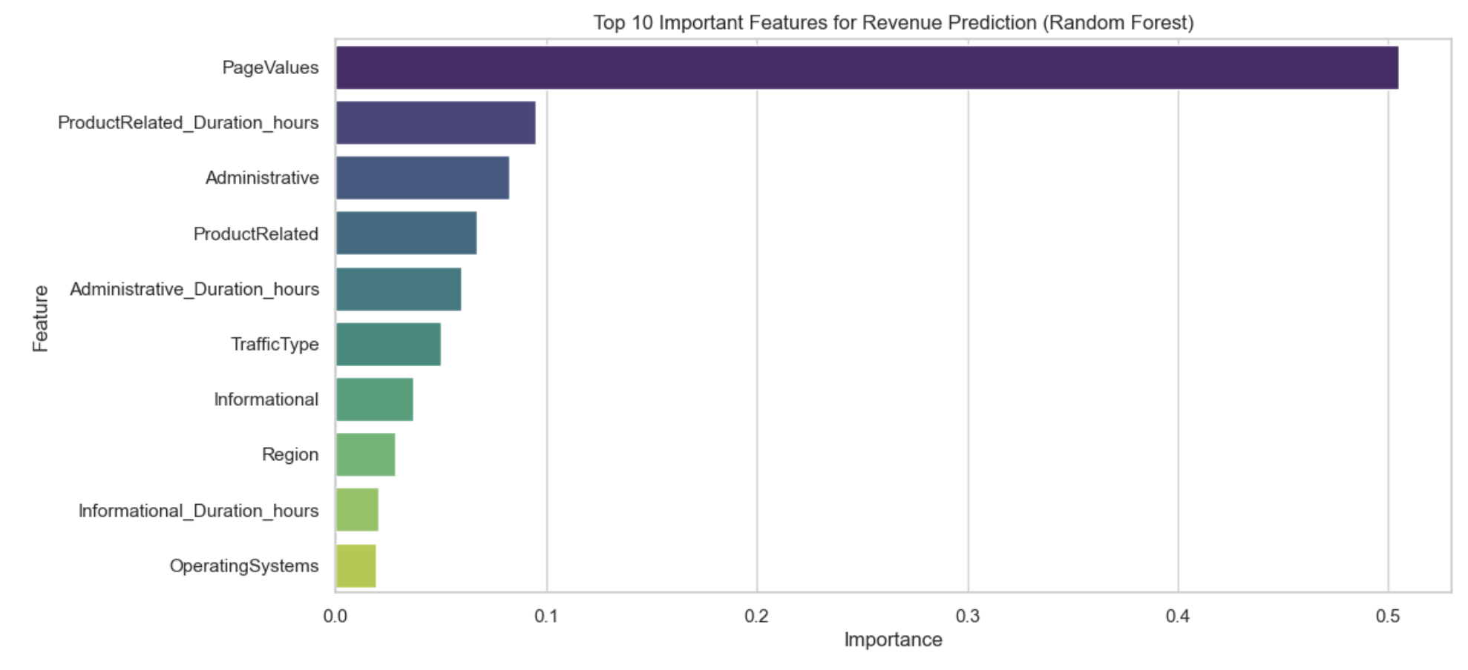
Feature Importance by Random Forest
"Page Values" seems to be the most impactful feature by a large margin

Slide 13
Conclusion
Random Forest model accurately predicts online purchase intent, achieving an exceptional ROC-AUC score of 0.982 - outperforming other models such as Logistic Regression, Decision Trees, XGBoost, Naive Bayes, SVM, and KNN
By leveraging customer browsing behavior, especially pageview patterns (top feature) and time spent on product pages, Random Forest model pinpoints promising sales opportunities
Future Work: Continuous monitoring, dimensionality reduction, feature engineering, Deep Learning models can potentially result in further improvement in revenue prediction

Slide 14
Thank you

